Slide 1
Second Reading of Proposed 2026 Budget
BYM Interim Meeting
January 31, 2026
Stewardship and Finance Committee
Notes:
I am Terence McCormally of Herndon Friends Meeting, currently serving as Treasurer of Baltimore Yearly Meeting. This is my first opportunity to address the Yearly Meeting as Treasurer, so it seems a good time to point out that I have no formal finance training, so it may be that my discussions about yearly meeting finances are sometimes more about the story behind the numbers than the numbers themselves. As Treasurer, I am a member of the Stewardship and Finance Committee, and it’s in that capacity that I am presenting the second reading of the 2026 budget.
People say lots of things about budgets: that a budget is a values statement, that a budget is a spiritual document, but at the bottom line, the budget is a plan—a plan for how the Yearly Meeting is going to accomplish what we want to do.
This second reading is markedly delayed mostly because of uncertainties in managing the part of the budget related to the camp program.

Slide 2
Camping Program Budget Deficit
Notes:
After being shut down by Covid in 2021, BYM camp’s had a remarkable recovery in 2022 and 2023, but in 2024 the camp program had a major loss
A lot of things contributed to that—overly optimistic projections on enrollment and how the sliding scale would affect camp revenue; with that, growing the staff team, , rapidly rising insurance costs
Many corrective measures have been taken, including reducing staff, a new emphasis on camper recruitment—which includes changing camp programs to be more attractive to a wider range of interests, and changes in implementation of the sliding scale.
The bottom line of this is that the camp deficit is being rapidly corrected. From a $350,000 deficit in 2024 to a $47,000 deficit in this budget to a projected $30,000 surplus in 2027.
This work is continuing

Slide 3
What Does the 2026 Budget Do?
Course corrects camp budgets and gets them on-track for a balanced operating budget in 2027, which has included substantial staffing adjustments (which take a little longer).
Revenue projections, especially camper fees, are realistic and based in prior-year actuals and next-year plans
Funds all other programs, anti-racism priorities, and contributions to outside organizations at a similar rate as 2025. No new programs or program expansions are funded in this budget.
Provide a Cost of Living Adjustment of 4% for staff (except GenSec, Camping Program Manager, & Camp Property Manager)

Slide 4
Changes in Budget Presentation
Clearly separate Camp and Non Camp Budgets
Clearly identify the use of “Releases from Restricted Funds”
Balance the budget by identifying use of Reserve Funds
Depreciation is reported “below the line” as non cash expense

Slide 5
Non Camp BYM Budget
BYM Camp Budget
Camping Program
Camping Property
Spiritual Formation
Youth Programs
Annual Session
Development
Publications
Ed Grants
STTQEF
STRIDE
Admin
The Administration Budget includes the site expenses for the yearly meeting office, bookkeeping, accounting, and HR services and software, but also maintaining the website and directories, providing support for committees, preparing and distributing the Yearbook and Faith and Practice. It also includes gifts to outside organizations, Committee Expenses, Educational Grants and the Sue Thomas Turner Education fund

Slide 6
This Budget is “LLC Agnostic”
It doesn’t depend on the decision we make about how to improve Camp Governance
It doesn’t include any provision for the expenses like legal fees or training that might be incurred in transitioning to a different form of Camp Governance

Slide 7
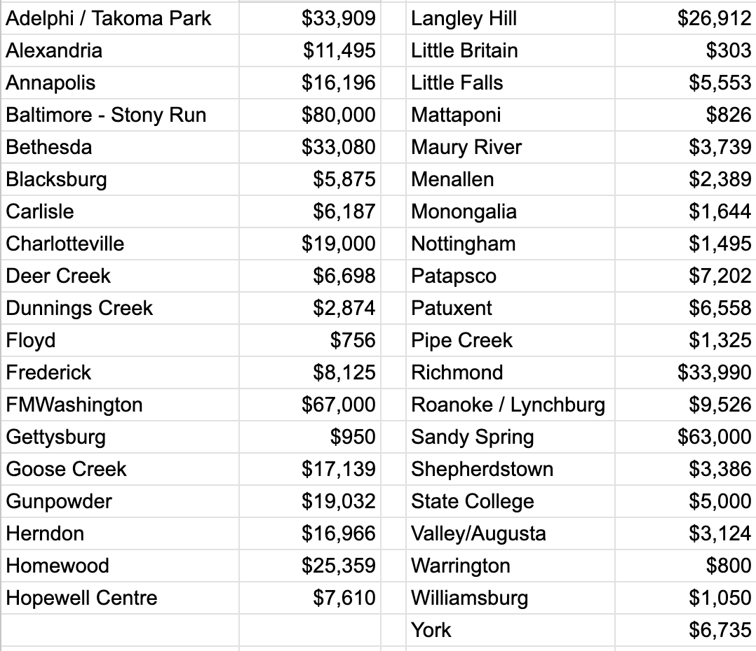
2026 Proposed Plan of Apportionment
Anticipated Total = about $564,000
Don’t forget! Your Meeting can adjust. Contact Catherine Tall, Apportionment Liaison, Stewardship & Finance.
cvtall@gmail.com
Notes:
The 2025 apportionment is still about $120,000 short of the budget; this may be in part due to unintended lapses or it might be due to monthly meetings deciding to contribute directly to camp programs. If possible please pay apportionmnet
The apportionment formula is an attempt to advise Monthly Meetings of what their equitable share of support to the Yearly Meeting would be, based on the relative income of each meeting. Because the formula does not consider the details of each meeting’s financial situation, it may not be realistic for all of our meetings. Apportionment is not a tax, nor membership dues, nor a purchase of services. If it was a tax, it would be a very regressive tax
Please let us know at the earliest opportunity if the proposed apportionment for next year does not speak to your condition. We want our Monthly Meetings to contribute out of their abundance and not create unnecessary hardship.

Slide 8
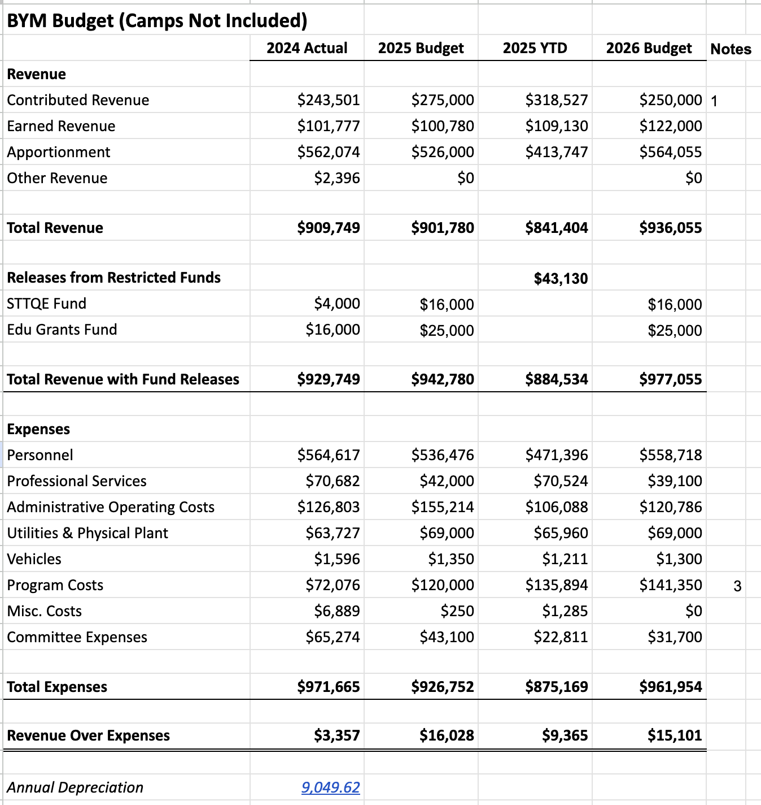
BYM Non Camp Budget
Income
Notes:
$120,000 apportionment deficit

Slide 9
BYM Non Camp Budget
EXPENSES

Slide 10
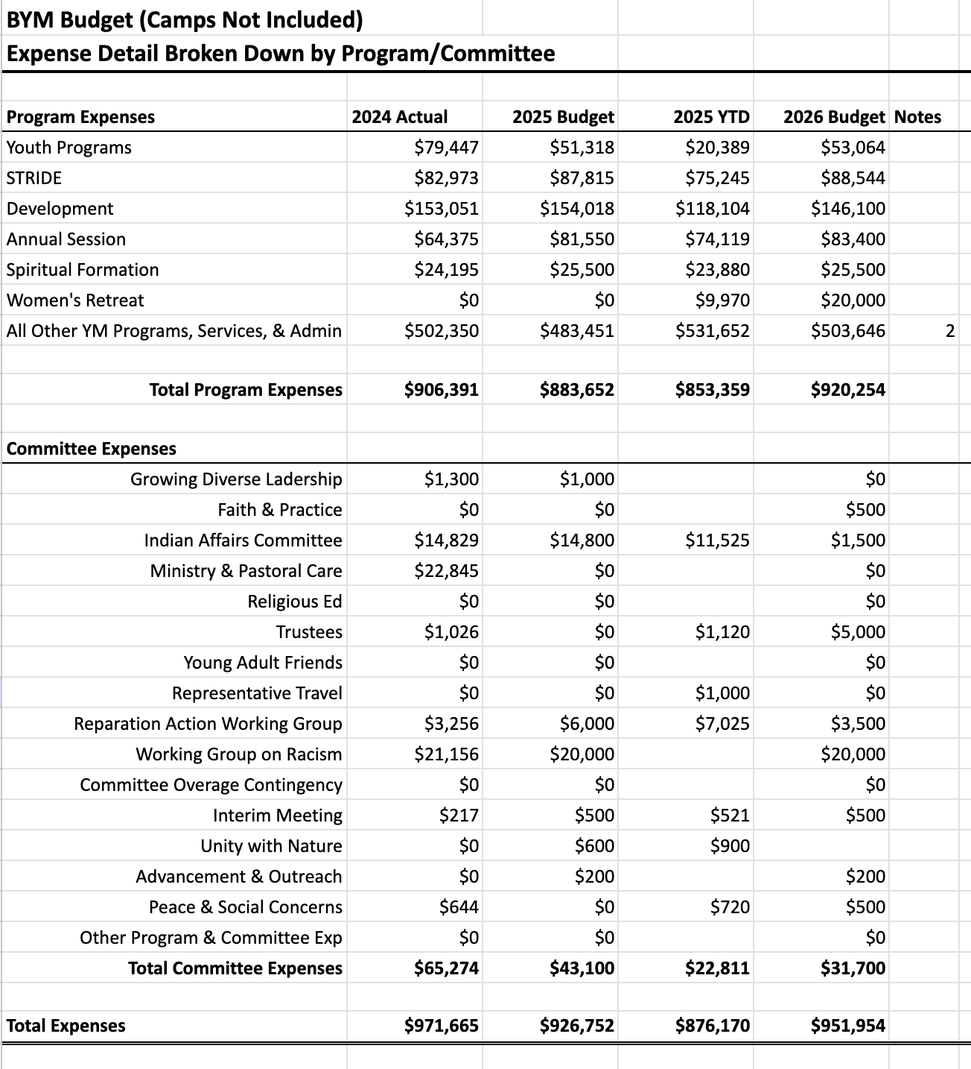
BYM Non Camp Budget
EXPENSES Broken Down By Program & Committee

Slide 11
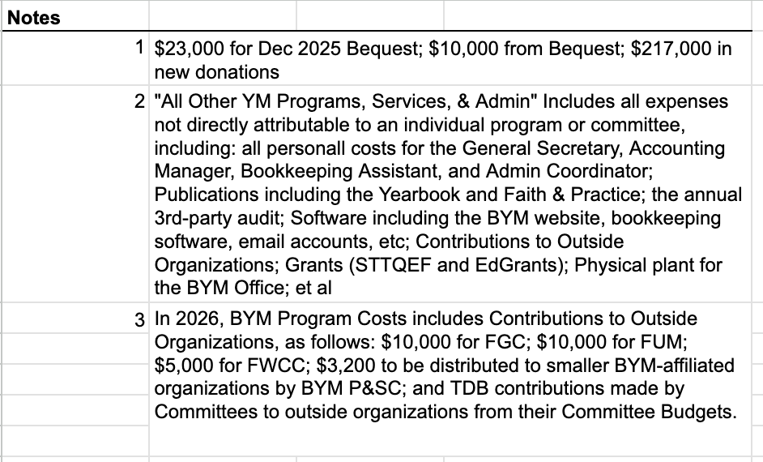

Slide 12
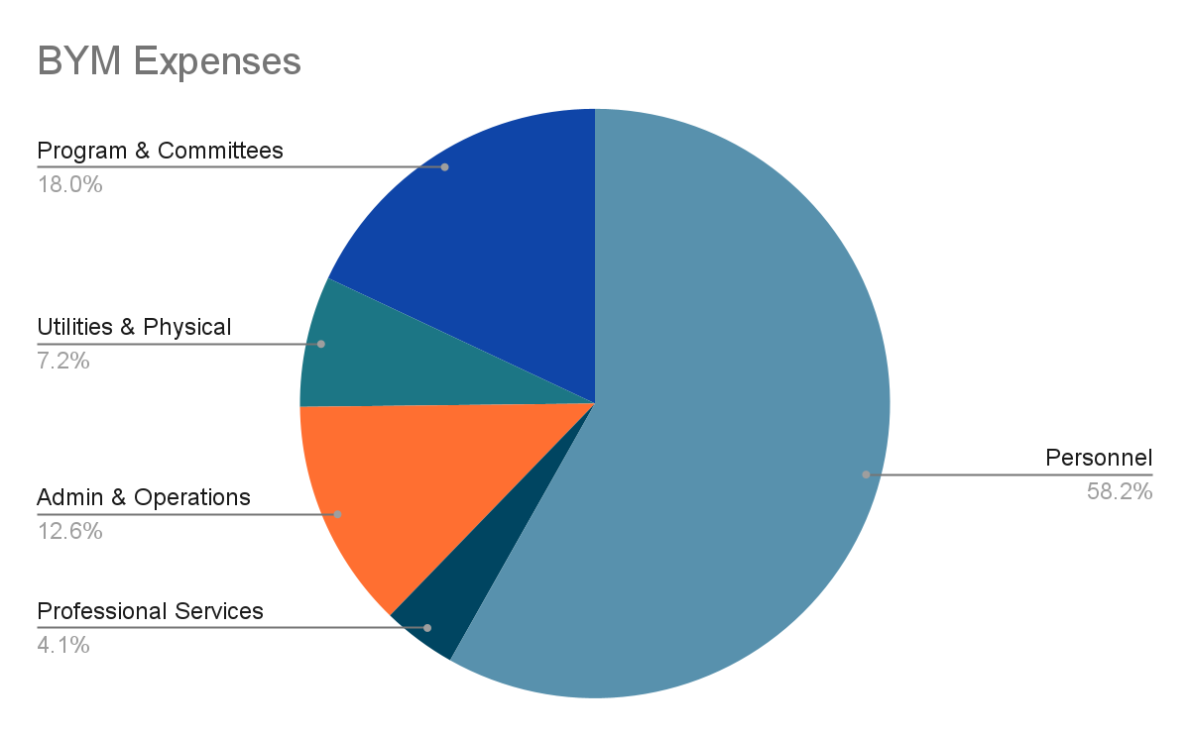
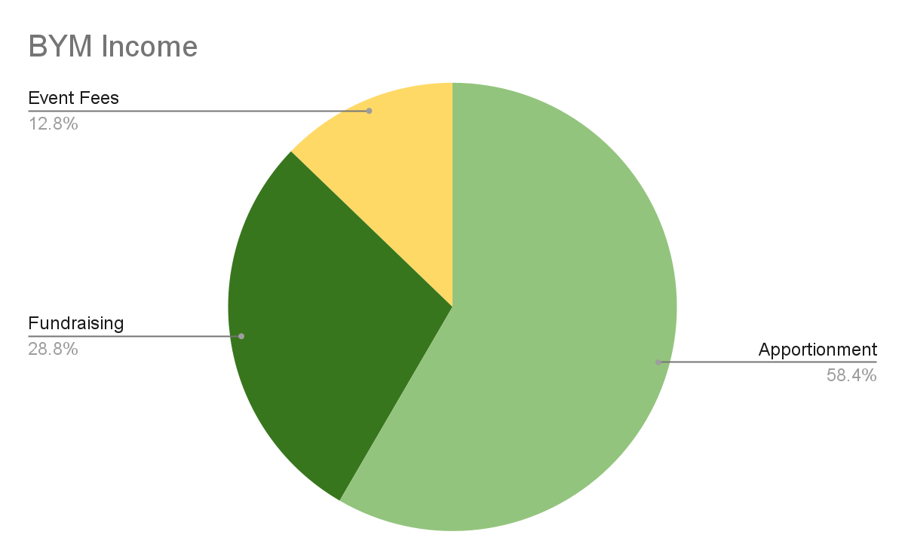
BYM Non Camp Expenses
BYM Non Camp Income
Of total BYM expenses, about $150,000 - or 16% - are in-kind services supporting camp, including bookkeeping & accounting, HR, compliance, fundraising, telecom, etc.

Slide 13
Policy on Contributions to Outside Orgs
  BYM contributes about 5% of apportionment income to outside orgs, with the bulk of that amount going towards the 3 Quaker orgs where BYM is a member and the rest shared equally among the other orgs
  We expect about $564,000 in Apportionment income in 2026
  Five percent = $28,200
  $25,000 to be shared among 3 member orgs
  $3,200 to share among other orgs (BYM Peace & Social Concerns will be asked to discern 2026 small gifts and bring proposal to June Interim Meeting)

Slide 14
2026 Contributions to Outside Orgs
Friends General Conference $10,000
Friends United Meeting $10,000
Friends World Committee $ 5,000
P&SC Contributions $ 3,200
BYM Peace & Social Concerns will recommend how to distribute this amount among the smaller organizations to whom BYM sends representatives. S&F will bring that finalized list for approval to a future Interim Meeting.
Reparations Action WG Contributions $ TBD

Slide 15
2026 Grants & Scholarships
BYM Educational Grants $21,000
Undergraduate and trade school scholarships. Open to children affiliated with BYM Monthly Meetings.
Sue Thomas Turner Quaker Education Grants $20,000
To support the understanding and use of Quaker faith and practice in school communities.

Slide 16
How Our Budget Supports Our Values
Being a good employer
  COLA increase for 2026 = 4%
  except GenSec, who will receive 0-2% COLA depending on camp income
  BYM provides full benefits to all staff who work year-round and at least half-time
  Needed Staff reductions are instituted with adequate notice
Being true to our commitment to be an Anti-Racist Faith organization
In 2026, 13% or $121,000 of the BYM Non CMP budget will be spent on anti-racism priorities.
  STRIDE Program
  Committee expenses – Working Group on Racism (62% of all Committee Expenses), Reparations Action Working Group, Indigenous Affairs Committee
  Staff DEI work
  Annual Session Honorariums
  New in 2026, the GenSec will implement women and minority-owned vendor priority..

Slide 17
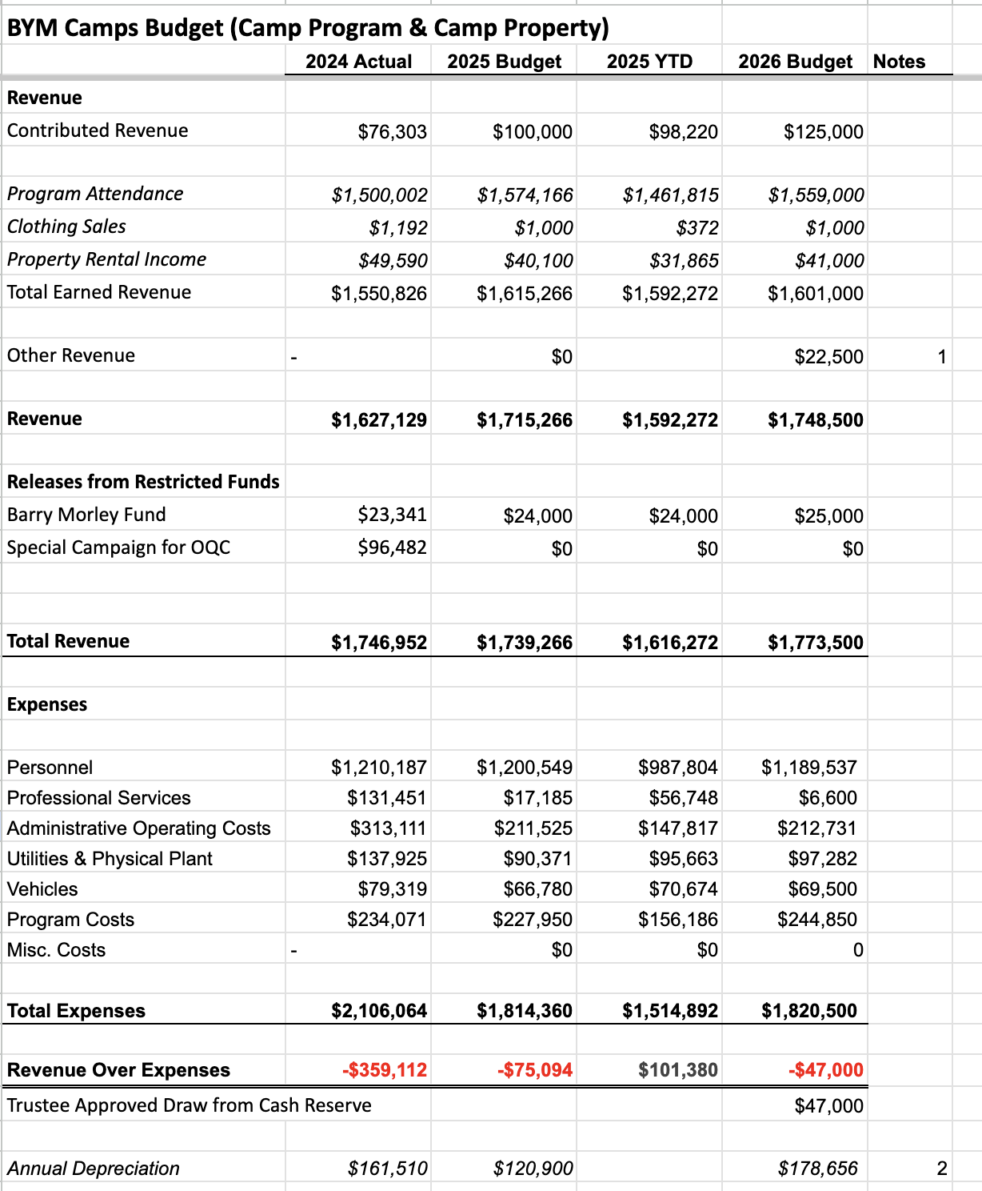
BYM Camps Budget (Camp Program & Camp Property Only), INCOME

Slide 18
BYM Camps Budget (Camp Program & Camp Property Only), EXPENSES

Slide 19
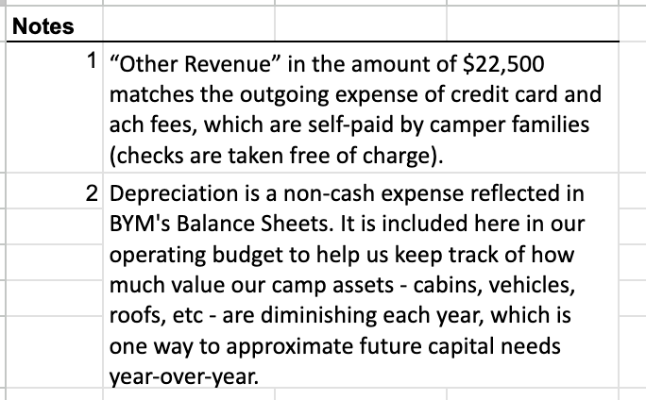

Slide 20
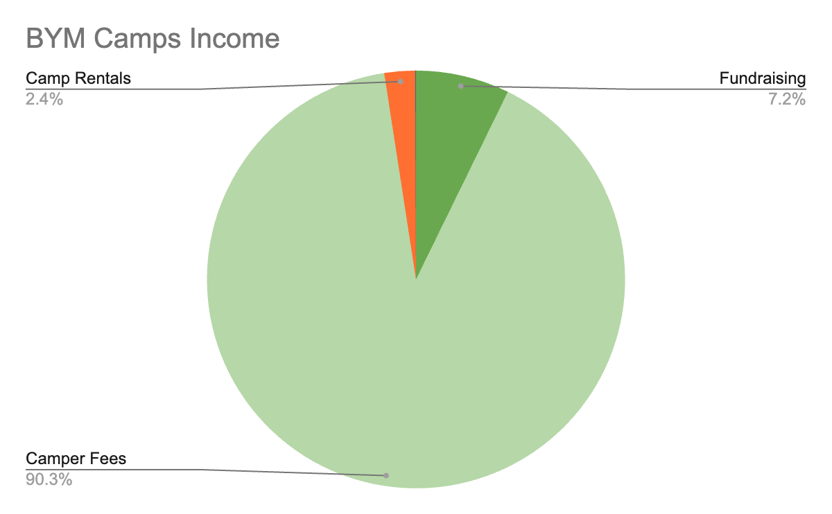
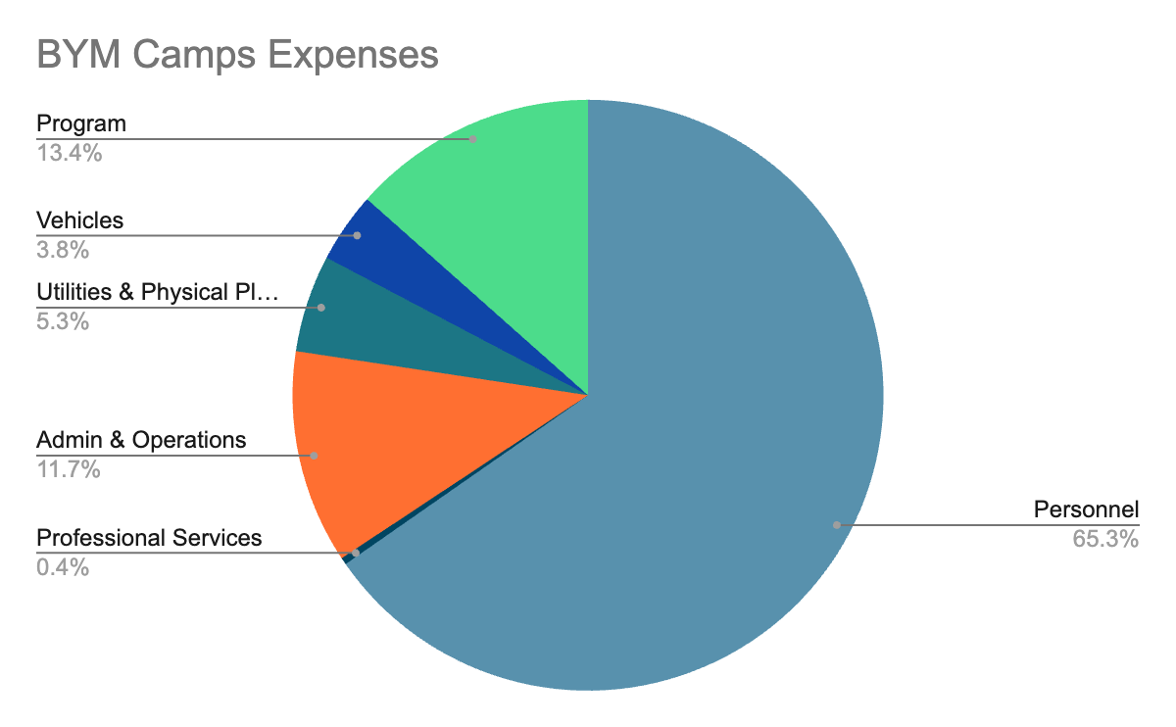
Camp Income
Camp Expenses
BYM Camps income & expenses do not include the $150,000 of in-kind services received from BYM for bookkeeping & accounting, HR, compliance, fundraising, telecom, etc.

Slide 21
2026 Camp Capital Budget
The “highest priority” camp capital improvement projects are funded for 2026 by existing designated and restricted funds.
There is insufficient money to cover camp capital expenses beyond 2026.

Slide 22
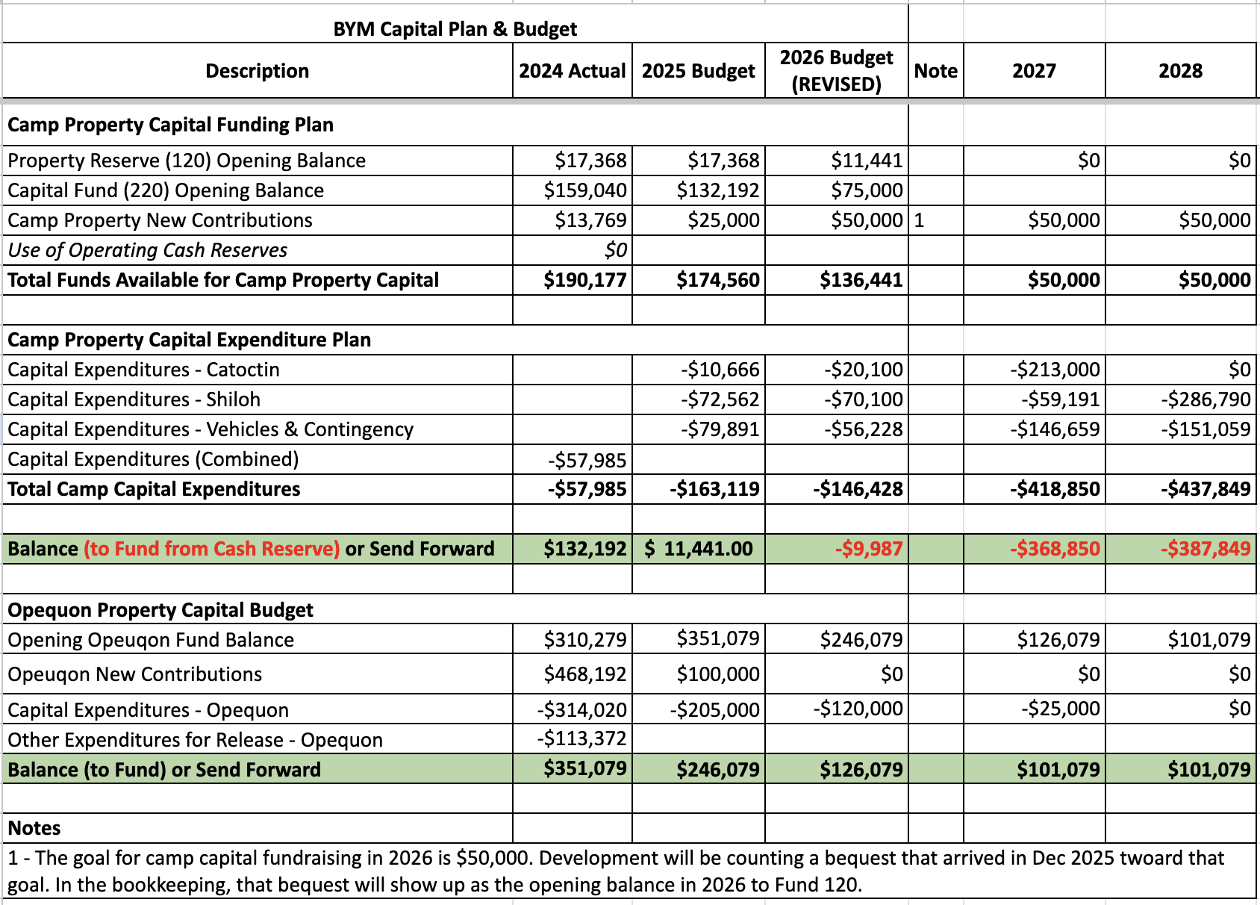

Slide 23
Looking Forward to the 2027 Budget
Budgeting process for 2027 has already started
We want to think about not just what we’ve been doing but also what we want to do, or what we want to do more of
  Provide more direct services to Monthly Meetings
  Expand anti racism and reparations work
  Respond to emerging challenges in our communities
  Increase Intervisitation
Committees to send ideas and budget requests for the 2027 year
Expect that Camp Budget will be available for approval at November Interim Meeting instead of Annual Session

Slide 24
2027 Budget Process
Jan-Aug Yearly Meeting Budgeting (not including camp prop & program)
April - Budget & Apportionment Meeting
June Interim Meeting - First Draft of 2027 Budget
August - First & Second Reading at Annual Session
A “defined contribution” of both in-kind and direct financial support of camp (for use in the camp budgeting process) will be included in all drafts of this budget.
Sept-Nov Camp Budgeting (camp program, camp property, camp capital)
Camp can no longer build its budgets in Jan/Feb - the budgeting timeline BYM uses. For example, Jan/Feb of 2026 is too far out from Summer 2027 to produce an accurate budget.
Sept-Nov - Going forward, camp will do its budgets in Late-Summer and Fall with presentation at November Interim Meeting.

Slide 25
Stewardship & Finance Committee
Catherine Nnoka (FMW). Interim Clerk
Anne Bacon (Hopewell Centre) | Catherine Tall (Monongalia)
Ann Duncan (Midlothian) | Karie Firoozmand (Stony Run)
Wesley Peters (FMW) | Tim Yeaney (Langley Hill)
Jeff Smith (Roanoke)
Ex Officio:Terence McCormally, Treasurer (Herndon) | Staff: Sarah Gillooly, General Secretary

