Slide 1
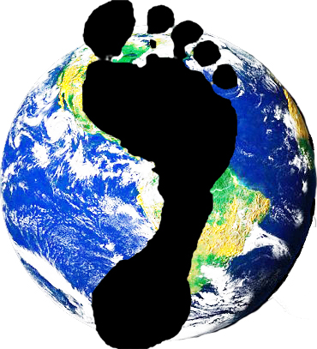
Carbon Footprint Training
Rick Morgan
BYM Unity with Nature Committee
at Sandy Spring Friends Meeting
February 24, 2019

Slide 2
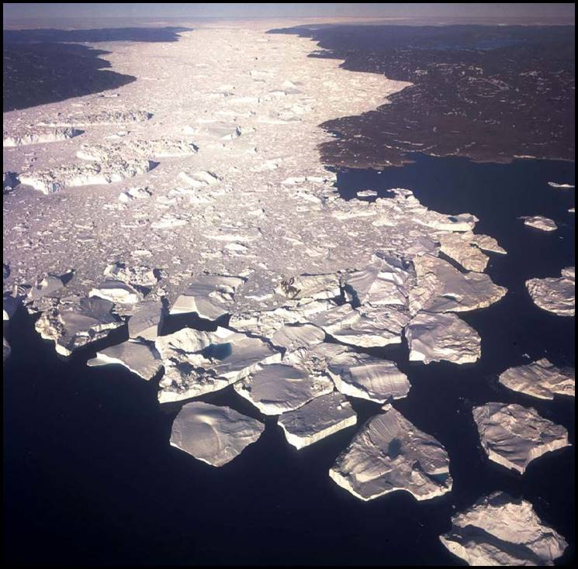
The context for carbon footprinting
Extreme weather, wildfires
Melting glaciers, sea level rise
US bailing from Paris Climate Accords
UN warns warming mustn’t exceed 1.5°C!
Where to begin?
Examine your own carbon footprint!

Slide 3
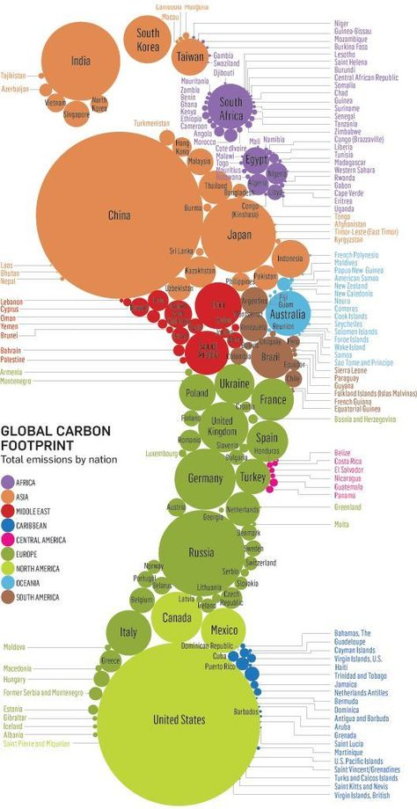
Comparing our carbon footprints worldwide
Annual U.S. per capita carbon emissions (~16 metric tons) are:
Nearly double most European countries’.
4 times worldwide average (~4 metric tons per capita).
8 times our fair share of carbon the earth can sequester*.
*~2.0 metric tons per capita annually, per 2015 Paris Climate Accords
Source: Stanford Kay

Slide 4
Climate queries posed by Friends
As a human community, do we need to limit our human caused CO₂ to equal or less than what can be sequestered?
Do we as individuals and nations need to share the limits of emissions fairly to avoid further CO₂ increases to the atmosphere?
--Unity with Nature Committee
Baltimore Yearly Meeting

Slide 5
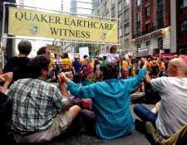
Reasons for footprinting
Tracking our carbon footprints is a form of witness to our own actions that impact the earth.
Footprinting can motivate us to:
make changes in our personal lifestyles.
work for cultural changes.
Results are eye-opening!
“When I can see my own footprint, I can’t be silent and complicit!”
http://coolclimate.berkeley.edu/maps

Slide 6
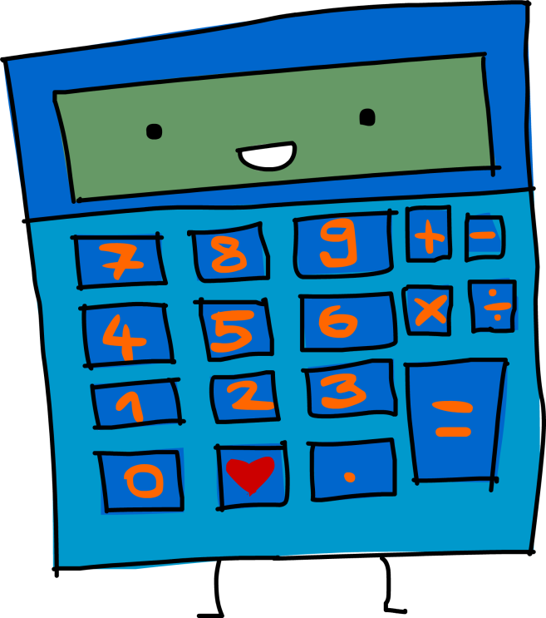
What makes a good carbon footprint calculator?
Key attributes of a good calculator include:
user-friendliness --accuracy
robustness --usefulness of results
No single calculator ideal in all respects.
Often tension between simplicity and accuracy.
Typical features:
Organized by sector modules (travel, housing, diet, etc).
Scores generally reported by household, not per capita.
Scores expressed in metric tons of CO2 annually
1 metric ton = ~1.1 “short” US ton.

Slide 7
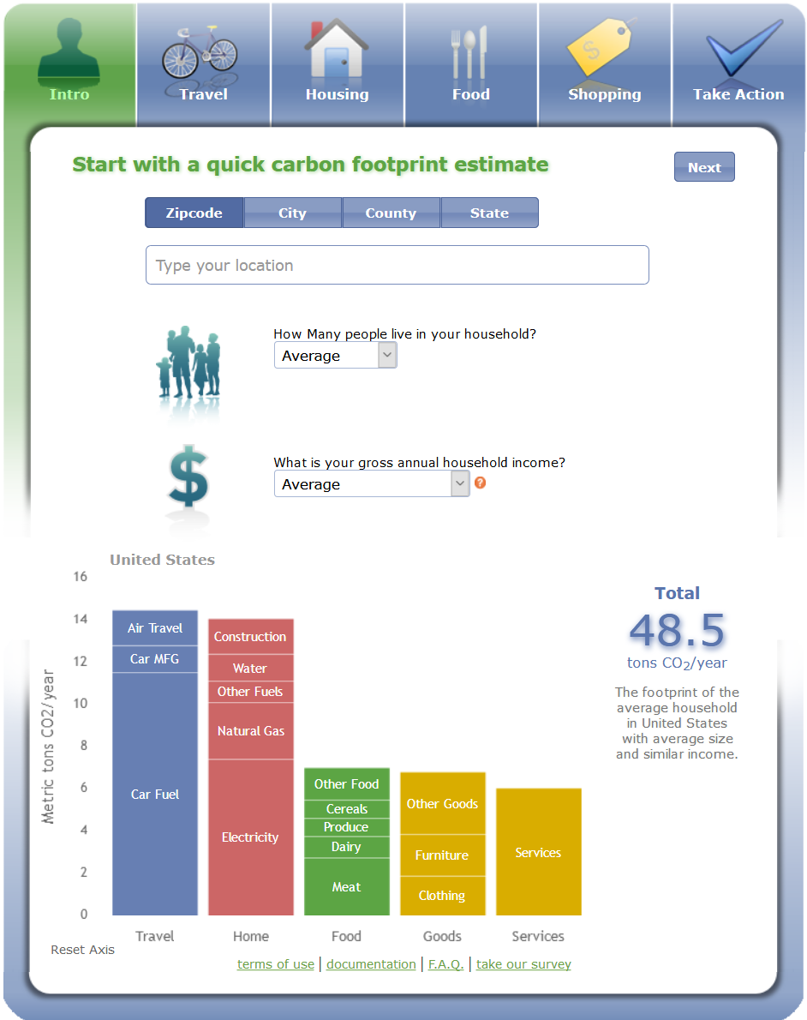
A leading on-line calculator:
UC-Berkeley’s CoolClimate*
Precise & easy to use
Choice of standard vs. advanced inputs
Air travel module accounts for high-altitude emissions
Documentation is thorough, transparent
‘Take Action’ list
* https://coolclimate.berkeley.edu/calculator
Phone-friendly version:
https://www.nature.org/en-us/get-involved/how-to-help/consider-your-impact/carbon-calculator/

Slide 8
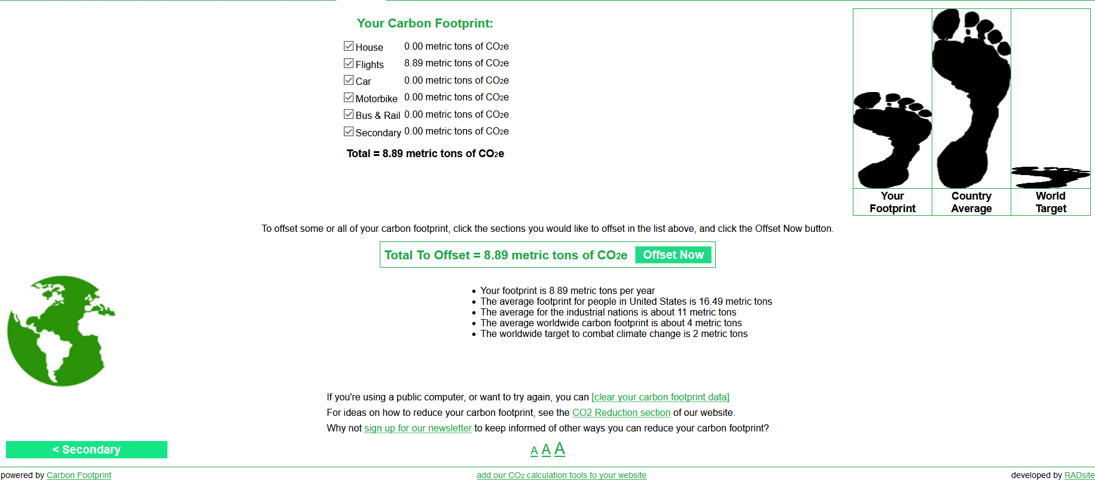
carbonfootprint.com (U.K.)
Versatile & easy to use
Optional high altitude adjustment for air travel
Score compared to your fair share of worldwide emissions target.
Hawking of “carbon offsets” may be objectionable to some.

Slide 9
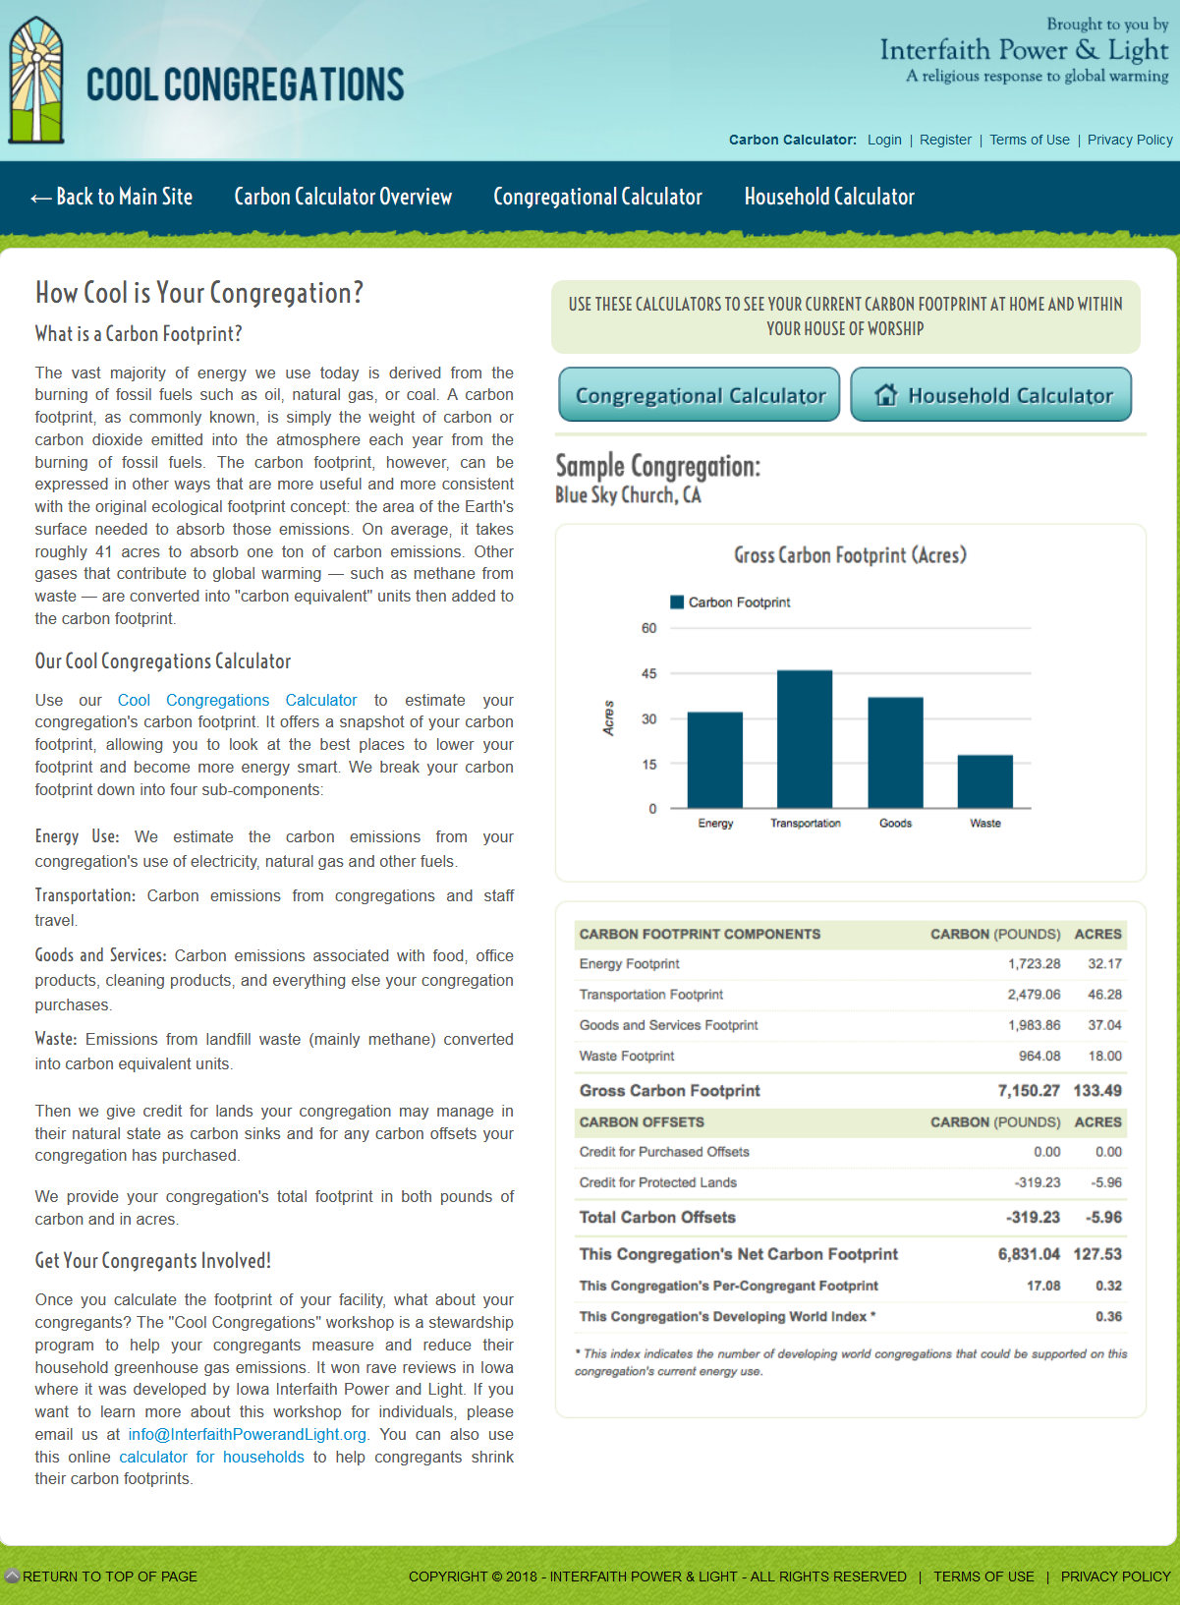
Cool Congregations*
(Interfaith Power & Light)
Calculates footprints for religious congregations
Accounts for energy use, staff travel
Estimates emissions associated with food, office products, cleaning products
Credit for congregation lands managed in their natural state
* http://www.coolcongregations.org/calculator/

Slide 10
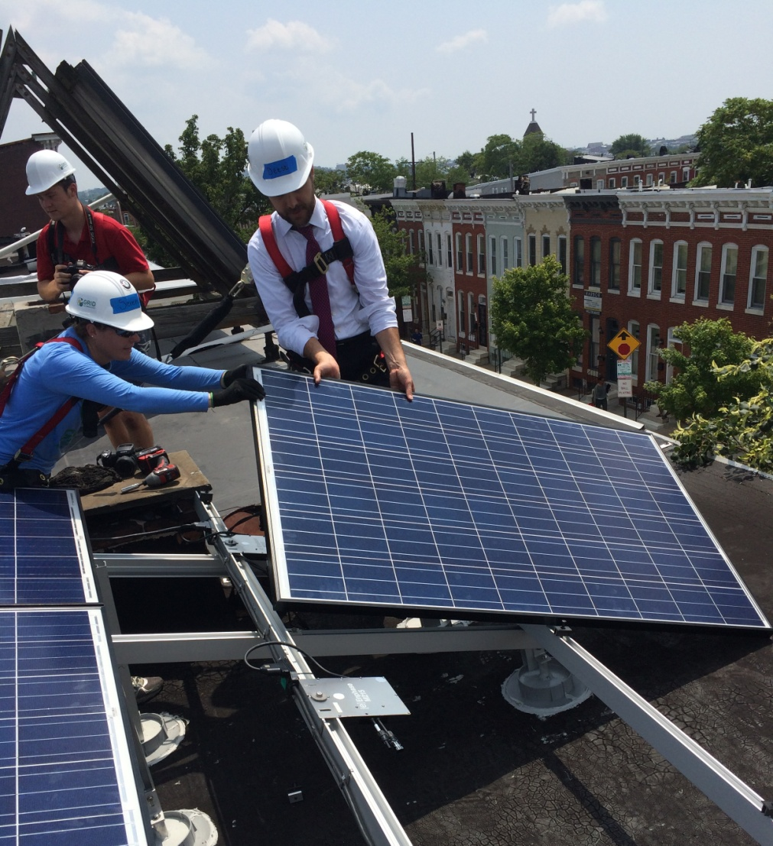
Take action, beginning today
Caring is not enough – Be the change!
Our individual actions are an important part of the solution.
Let’s look at some ways to cut your household’s footprint by 1+, 5+ and 10+ tons /yr.

Slide 11
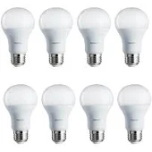
Cut your footprint at least 1 ton
Switch to LED bulbs
(30+ bulbs)
Switch to Low-Flow Shower Heads
<$2 per bulb; Save money!
More comfort in summer!
Good models provide a nice shower.
Much better than the 1980s version.
Cut a round-trip flight to Atlanta, Chicago or Toronto.
Stop eating beef and pork in a 2-person household.
Switch to high-efficiency water heater or front-load washing machine.
Many more!

Slide 12
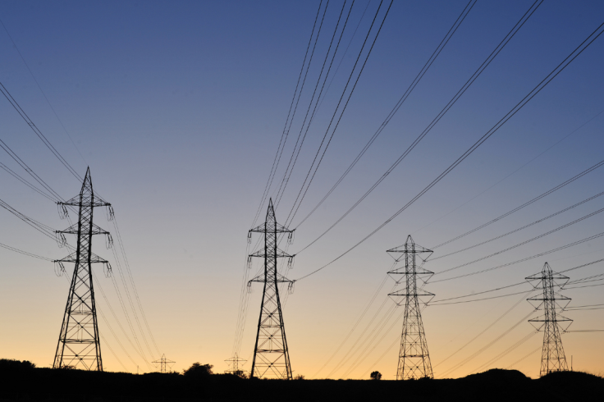
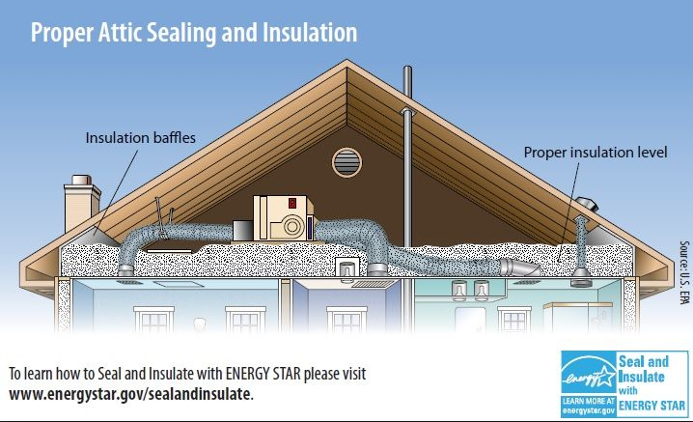
Cut your footprint at least 5 tons
Change Electricity Provider
Seal and Insulate
e.g. solar and wind plans
Easy to switch
Rates very close to PEPCO’s
10+ tons for some households
Improves comfort too!
Most effective for older, single family homes.
Cut a 2-person flight to California or Europe.
Switch 2 vehicles to hybrid cars, or 1 car to transit.
Install solar panels.
Many more!
Notes:
Example plans:
Neighborhood Sun
Groundswell Energy

Slide 13
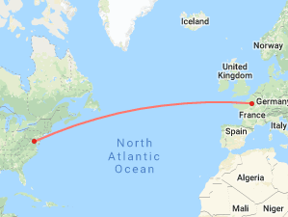
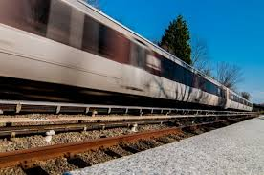
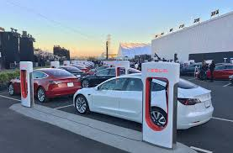
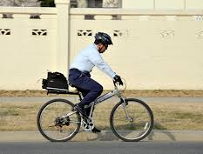
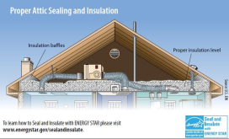
Cut your footprint at least 10 tons
Cut a 4-person trip to Europe or 2-person trip to Asia.
Switch 2 vehicles to transit, EV, or bicycle
Combine Actions
Electrify gas appliances.
Move to a smaller place.
Many more!

Slide 14
Takeaways re: carbon footprints
Our carbon footprints are driven by our culture.
Societal infrastructure reinforces consumptive lifestyles.
Modifying behavior alone won’t solve climate change.
→Work for societal change!
Still plenty of things you can control.
energy --travel
diet --purchases

Slide 15
Additional slides

Slide 16
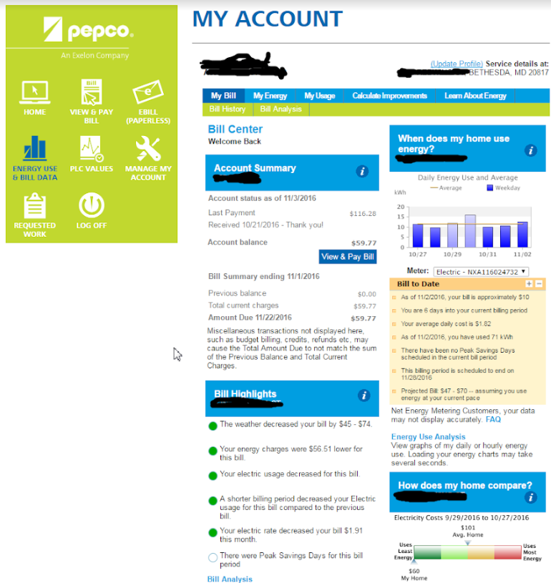
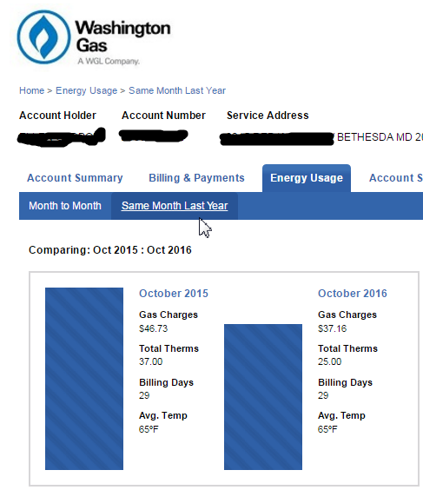
Sample Utility Bills for Footprint

Slide 17
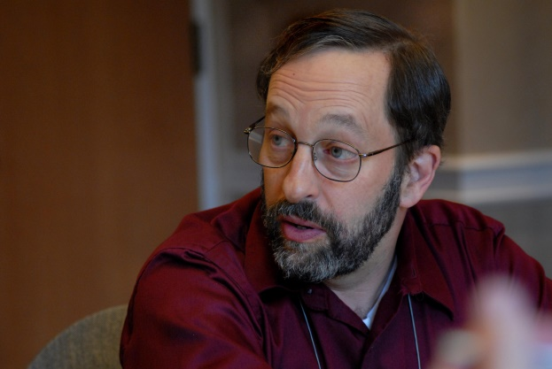
Presenter
Rick Morgan, Bethesda Friends Meeting
Commissioner, DC Public Service Commission, 2003-2011 (retired)
Economist; Creator of EPA’s “eGRID” database of US power plants
Member, Unity with Nature Committee, Baltimore Yearly Meeting (Quakers)

Slide 18
Carbon Footprint Resources
Environmental Sustainability Group, Bethesda Friends Meeting, February 2019
Leading carbon footprint calculators:
CoolClimate Network (U.C. Berkeley)
https://coolclimate.berkeley.edu/calculator (calculator)
https://www.nature.org/en-us/get-involved/how-to-help/consider-your-impact/carbon-calculator/ (Nature Conservancy’s phone-friendly interface for CoolClimate’s calculator)
carbonfootprint.com (U.K)
http://calculator.carbonfootprint.com/calculator.aspx
Cool Congregations (Interfaith Power & Light)
http://www.coolcongregations.org/calculator/
Other resources:
CoolClimate Network’s map of US household carbon footprint by Zip Code
http://coolclimate.berkeley.edu/maps
EPA's greenhouse gas equivalency calculator
https://www.epa.gov/energy/greenhouse-gas-equivalencies-calculator?unit=gasoline&amount=100

